Slide 1

ADVERTISEMENT ANALYSIS
Presented by
KIRUBA T

Slide 2
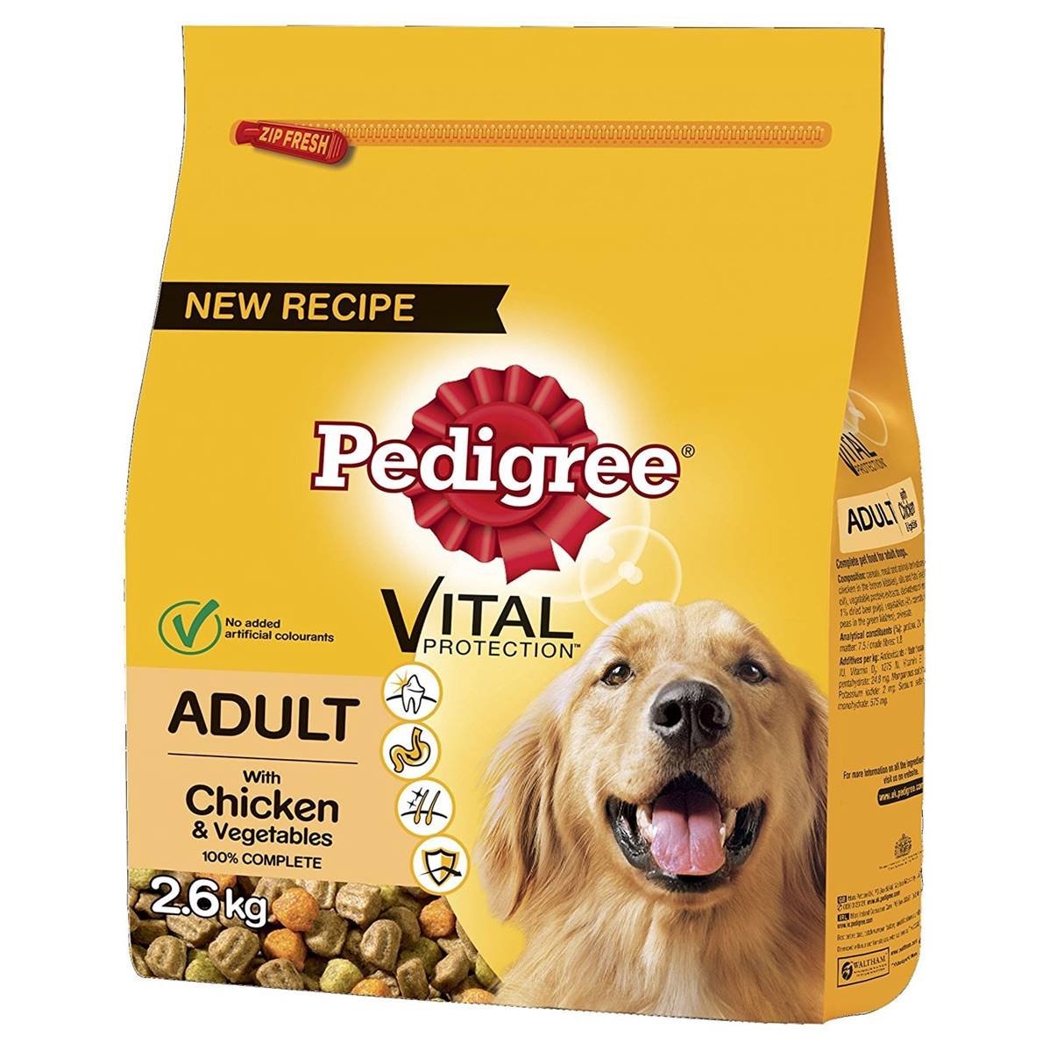
PEDIGREE
Subsidiary of the American group Mars, Incorporated
pedigree.com
Founded : 1957
Employees: 1,200
Parent organization: Mars

Slide 3
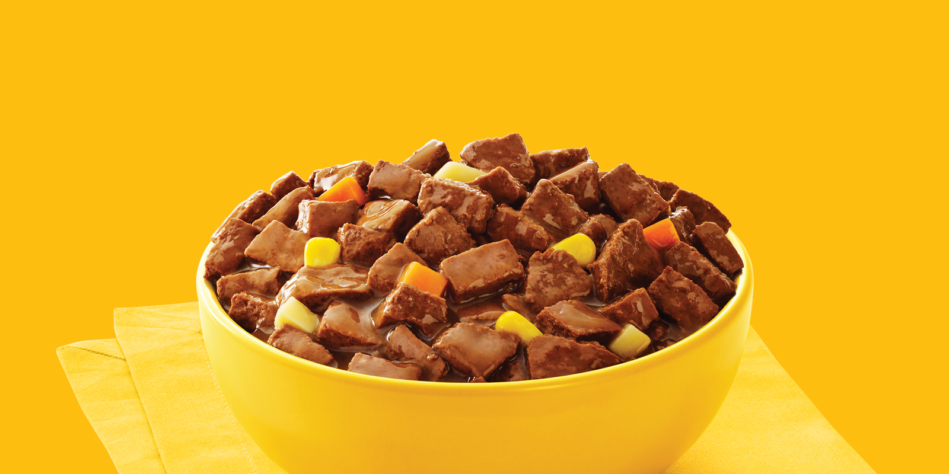

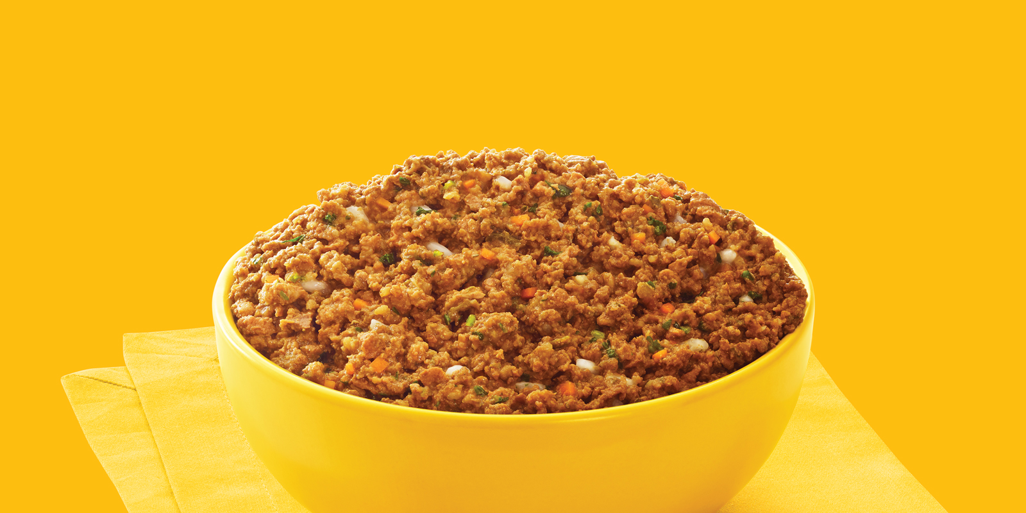
Introduction
Pedigree likes to put an emphasis on the relationship between owner and pet. They believe dogs make us better people. As such it is important that we “feed the good” in every dog. Pedigree also makes a commitment to shelter homeless dogs. I believe these values really drive home their commitment to not just dogs but animals. People view their pets as family and only want the best for them. That being said pedigree sets itself apart by being the most committed to seeing the best for dogs.

Slide 4

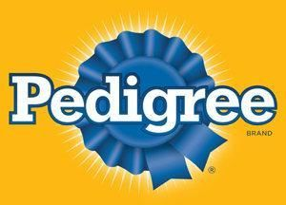
First Advertisement launched on 1999
Subsidiary of the American group Mars, Incorporated

Slide 5


TARGET AUDIENCE
The imagery on the pedigree website is unisex, showing pet owners of all genders and age groups.
Being dog food company of course, most of the imagery is centered around the dogs themselves of various breeds and age.
Most if not all of their print ads keep dogs the main focus. As dogs cannot read (as far as we know) it’s only natural to assume that the imagery is targeting dog owners.
There is no age limit on owning a dog, so the brand targets young and old. The only criteria is whether you own or care for dogs.

Slide 6
BRAND ANALYSIS
Line of Products includes:
Dog and puppy food – both wet and dry
An array of treats
“Dogs Rule” dog pride line of dog and people apparel
Many varieties of food for different sizes, ages, and health needs

Slide 7
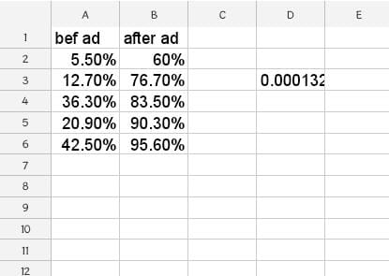
Table

Slide 8
HYPOTHESIS TEST
STEP1: Y=SALES, X=Sales BEFORE and AFTER Launching an ADVERTISEMENT
STEP2: ALPHA value=0.05
STEP3: PAIRED TEST
STEP4: H0=muA equal to muB ,H1=muA not equal to muB
STEP5:P Value=0.000133
STEP6:P=0.000133 Alpha=0.05
STEP7: p<Alpha P is LOW
STEP8: Null is REJECTED
STEP9: There is a DIFFERENCE in sales before launching an add and after launching an add
STEP10: Hence Y is affected by X

Slide 9
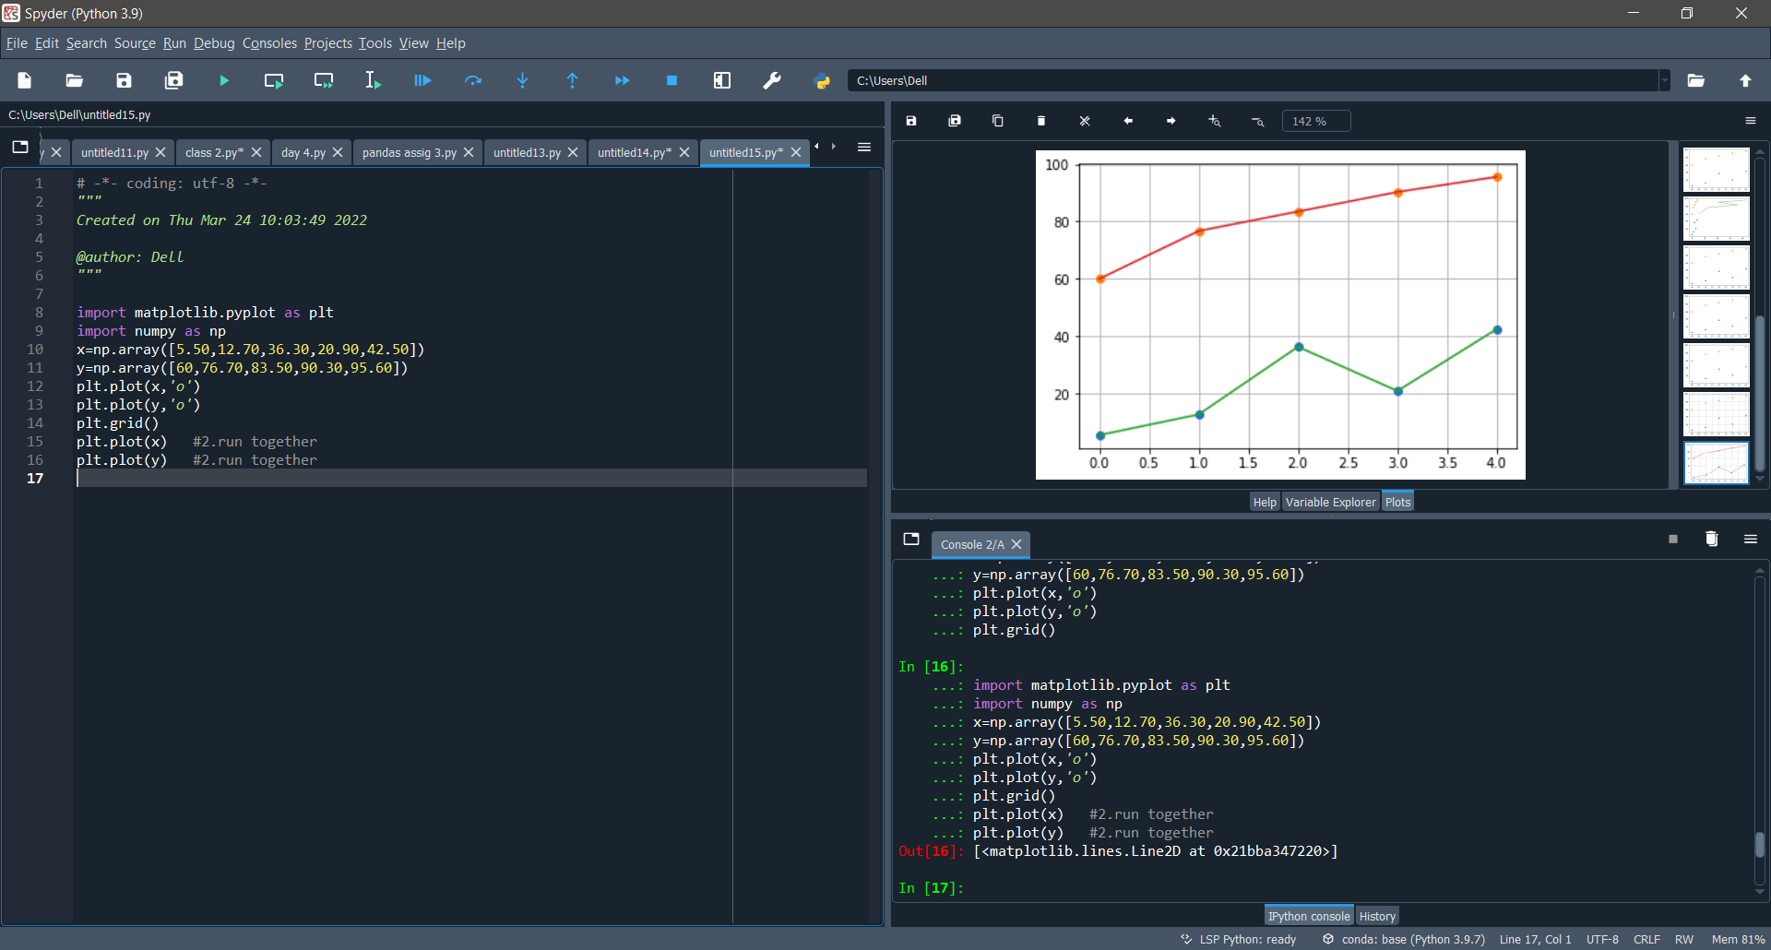
GRAPHICAL REPRESENTATION

Slide 10
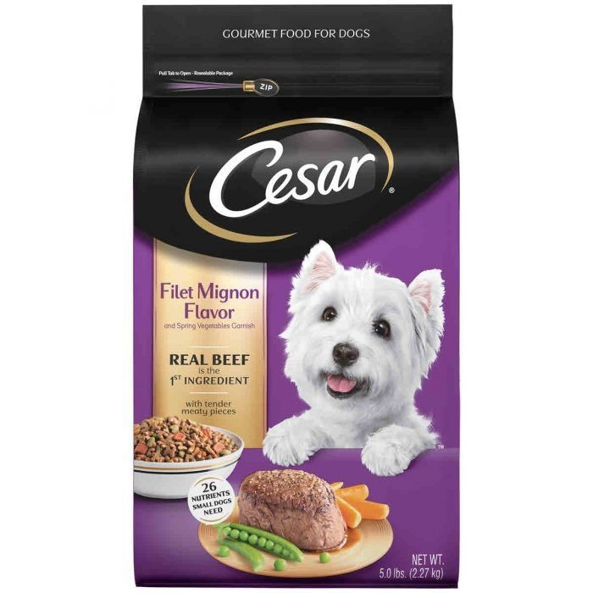
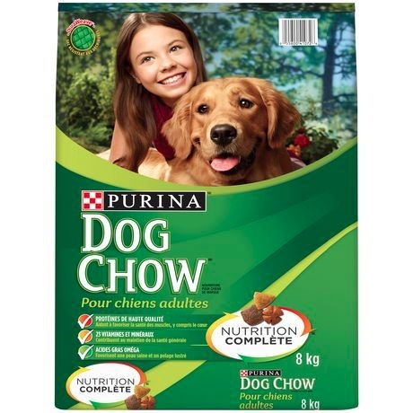
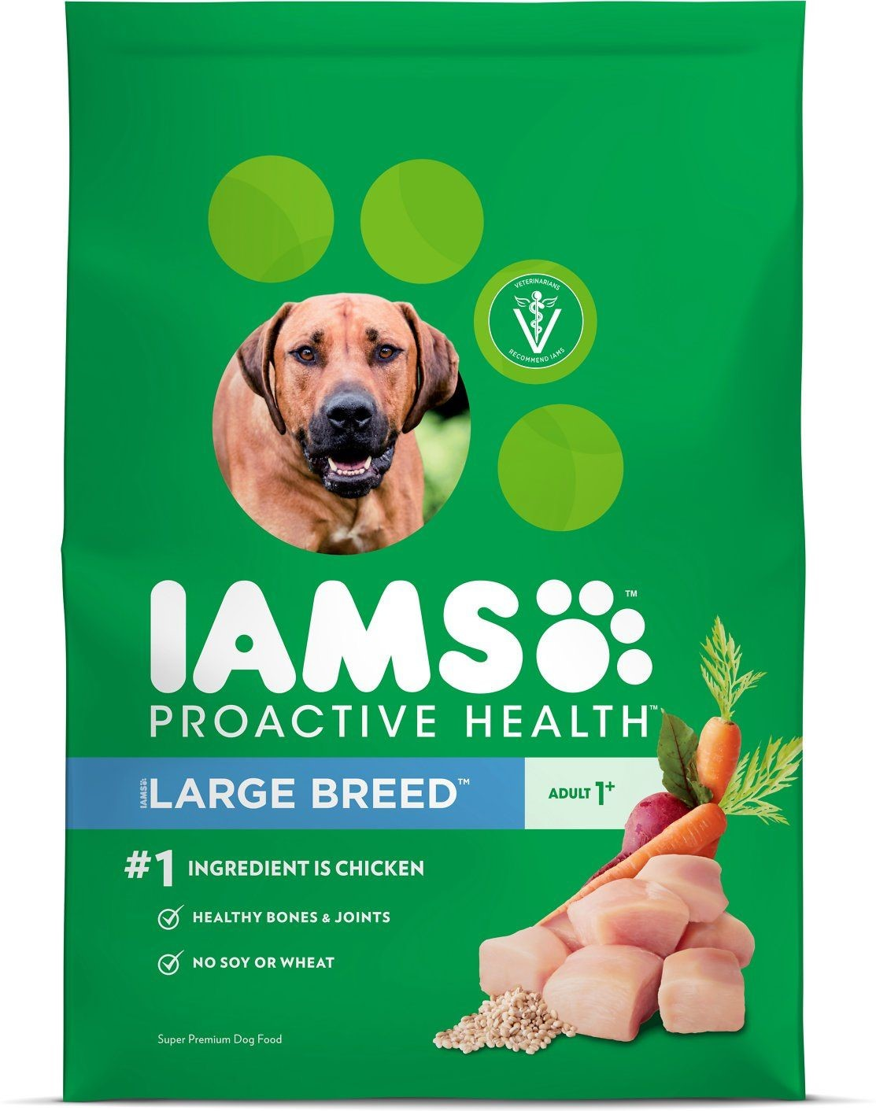
COMPETITORS
Pedigree falls under the umbrella company Royal CaninCanada dog food. Its competition is as follows.

Slide 11

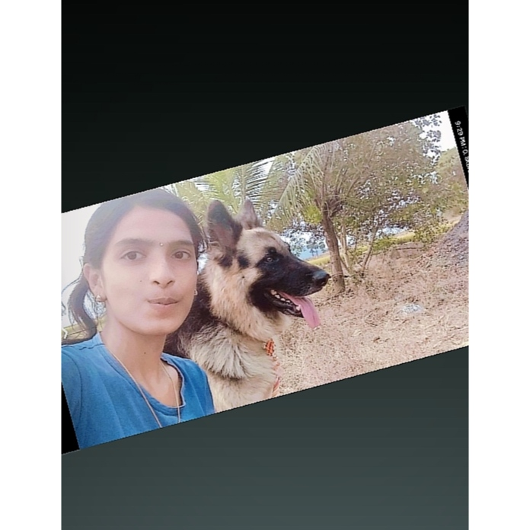

MY RATINGS For PEDIGREE, Since I own a dog

Slide 12
THANK YOU

